Slide 1
Chapter 2
Network Models
2.<number>

Slide 2
2-1 LAYERED TASKS
A network model is a layered architecture
  Task broken into subtasks
  Implemented separately in layers in stack
  Functions need in both systems
  Peer layers communicate
Protocol:
  A set of rules that governs data communication
  It represents an agreement between the communicating devices
2.<number>

Slide 3

Figure 2.1 Tasks involved in sending a letter
Topics discussed in this section:
Sender, Receiver, and Carrier
Hierarchy (services)
2.<number>

Slide 4
2-2 THE OSI MODEL
Established in 1947, the International Standards Organization (ISO) is a multinational body dedicated to worldwide agreement on international standards.
An ISO is the Open Systems Interconnection (OSI) model is the standard that covers all aspects of network communications from ISO. It was first introduced in the late 1970s.
2.<number>

Slide 5
ISO is the organization.
OSI is the model.
Topics discussed in this section:
Layered Architecture
Peer-to-Peer Processes
Encapsulation
2.<number>

Slide 6

Layered Architecture
Layers
Layer 7. Application
Layer 6. Presentation
Layer 5. Session
Layer 4. Transport
Layer 3. Network
Layer 2. Data Link
Layer 1. Physical
Figure 2.2 Seven layers of the OSI model
Sender
Receiver
2.<number>

Slide 7
Layered Architecture
A layered model
Each layer performs a subset of the required communication functions
Each layer relies on the next lower layer to perform more primitive functions
Each layer provides services to the next higher layer
Changes in one layer should not require changes in other layers
The processes on each machine at a given layer are called peer-to-peer process
2.<number>

Slide 8
PEER – TO – PEER PROCESS
Communication must move downward through the layers on the sending device, over the communication channel, and upward to the receiving device
Each layer in the sending device adds its own information to the message it receives from the layer just above it and passes the whole package to the layer just below it
At the receiving device, the message is unwrapped layer by layer, with each process receiving and removing the data meant for it
2.<number>

Slide 9
PEER – TO – PEER PROCESS
The passing of the data and network information down through the layers of the sending device and backup through the layers of the receiving device is made possible by interface between each pair of adjacent layers
Interface defines what information and services a layer must provide for the layer above it.
2.<number>

Slide 10

Figure 2.3 The interaction between layers in the OSI model
2.<number>

Slide 11

Figure 2.4 An exchange using the OSI model
2.<number>

Slide 12
2-3 LAYERS IN THE OSI MODEL
Topics discussed in this section:
Physical Layer
Data Link Layer
Network Layer
Transport Layer
Session Layer
Presentation Layer
Application Layer
2.<number>

Slide 13
Physical Layer
The physical layer is responsible for movements of
individual bits from one hop (node) to the next.
Function
  Physical characteristics of interfaces and media
  Representation of bits
  Data rate
  Synchronization of bits
  Line configuration (point-to-point or multipoint)
  Physical topology (mesh, star, ring or bus)
  Transmission mode ( simplex, half-duplex or duplex)
2.<number>

Slide 14

Figure 2.5 Physical layer
2.<number>

Slide 15
Data Link Layer
The data link layer is responsible for moving
frames from one hop (node) to the next.
Function
  Framing
  Physical addressing
  Flow control
  Error control
  Access control
2.<number>

Slide 16

Figure 2.6 Data link layer
2.<number>

Slide 17

Figure 2.7 Hop-to-hop delivery
2.<number>

Slide 18
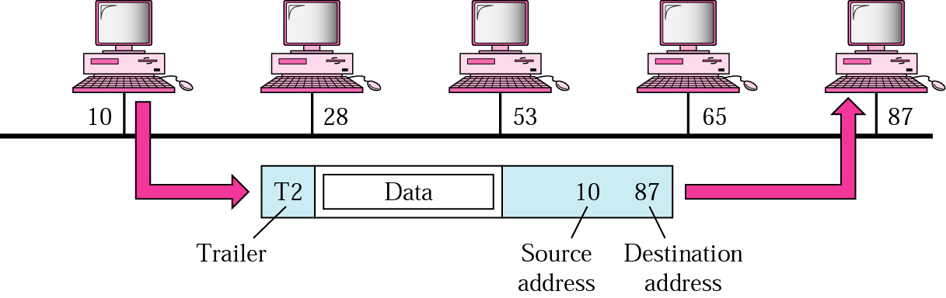
Example 1
In following Figure a node with physical address 10 sends a frame to a node with physical address 87. The two nodes are connected by a link. At the data link level this frame contains physical addresses in the header. These are the only addresses needed. The rest of the header contains other information needed at this level. The trailer usually contains extra bits needed for error detection
2.<number>

Slide 19
Network Layer
The network layer is responsible for the
delivery of individual packets from
the source host to the destination host.
Source-to-destination delivery
Responsible from the delivery of packets from the original source to the final destination
Functions
  Logical addressing
  routing
2.<number>

Slide 20

Figure 2.8 Network layer
2.<number>

Slide 21

Figure 2.9 Source-to-destination delivery
2.<number>

Slide 22
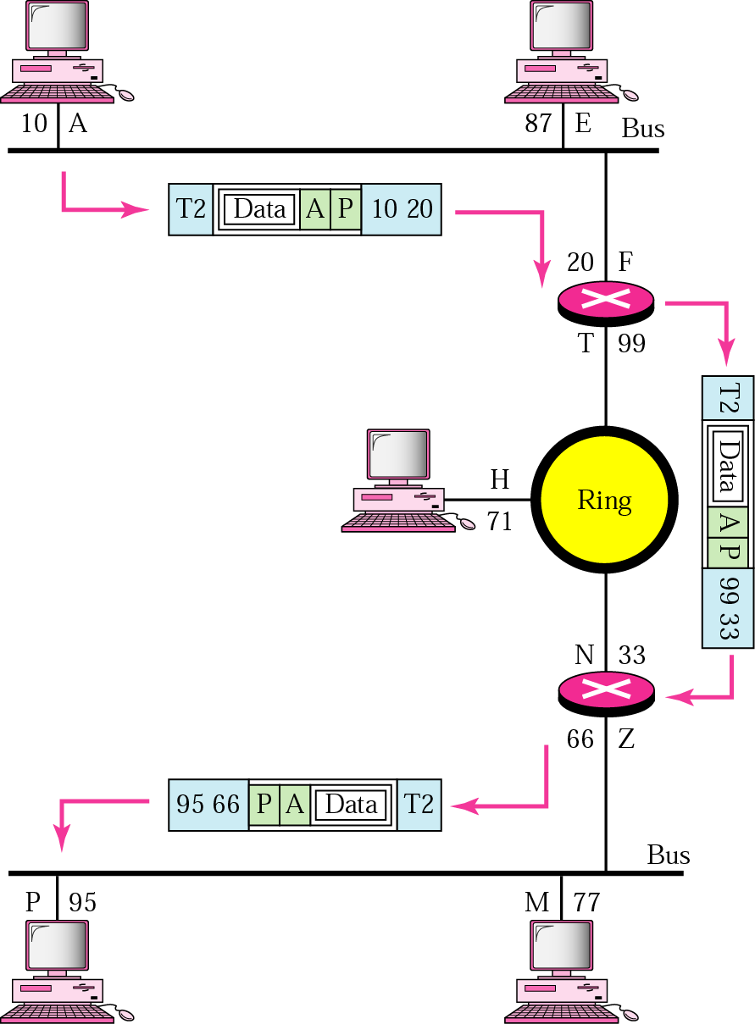
Example 2
We want to send data from a node with network address A and physical address 10, located on one LAN, to a node with a network address P and physical address 95, located on another LAN. Because the two devices are located on different networks, we cannot use physical addresses only; the physical addresses only have local influence. What we need here are universal addresses that can pass through the LAN boundaries. The network (logical) addresses have this characteristic.
2.<number>

Slide 23
Transport Layer
The transport layer is responsible for the delivery
of a message from one process to another.
Process-to- process delivery
Functions
  Port addressing
  Segmentation and reassembly
  Connection control ( Connection-oriented or connection-less)
  Flow control
  Error control
2.<number>

Slide 24

Transport layer
Segmentation and reassembly
2.<number>

Slide 25

Figure 2.11 Reliable process-to-process delivery of a message
2.<number>

Slide 26
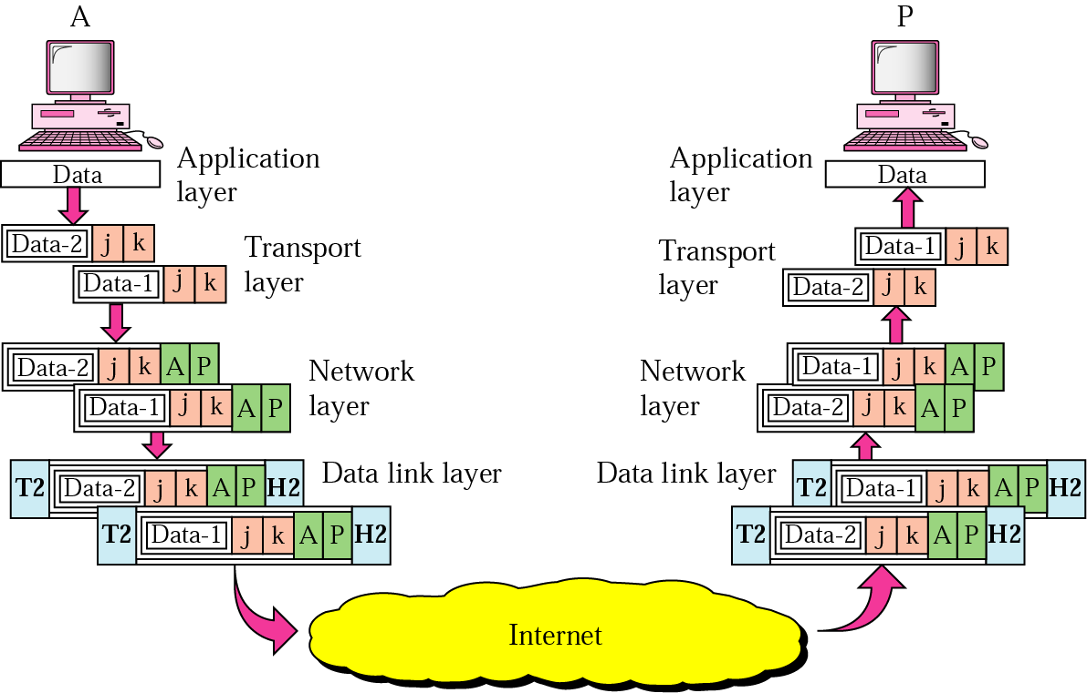
Example 3
Following Figure shows an example of transport layer communication. Data coming from the upper layers have port addresses j and k (j is the address of the sending process, and k is the address of the receiving process). Since the data size is larger than the network layer can handle, the data are split into two packets, each packet retaining the port addresses (j and k). Then in the network layer, network addresses (A and P) are added to each packet.
2.<number>

Slide 27
Session Layer
The session layer is responsible for dialog
control and synchronization.
  It establishes, maintains and synchronize the interaction between communicating system
  Function
    Dialog control
    Synchronization (checkpoints)
2.<number>

Slide 28

Session layer
Synchronization
2.<number>

Slide 29
Presentation Layer
The presentation layer is responsible for translation, compression, and encryption.
  Concerned with the syntax and semantics of the information exchanged between two system
  Functions
    Translation ( EBCDIC-coded text file → ASCII-coded file)
    Encryption and Decryption
    Compression
2.<number>

Slide 30

Figure 2.13 Presentation layer
2.<number>

Slide 31
Application Layer
The application layer is responsible for
providing services to the user.
Functions
  Network virtual terminal (Remote log-in)
  File transfer and access
  Mail services
  Directory services (Distributed Database)
  Accessing the World Wide Web
2.<number>

Slide 32

Figure 2.14 Application layer
2.<number>

Slide 33

Figure 2.15 Summary of layers
2.<number>

Slide 34
Figure 2.15 Summary of layers
OSI Model
 | Data unit | Layer | Function
User support layers | Data | 7. Application | Network process to application
 |  | 6. Presentation | Data representation and encryption
 |  | 5. Session | Inter-host communication
User⬄ Network | Segment | 4. Transport | End-to-end connections and reliability
Network support layers | Packet | 3. Network | Path determination and logical addressing
 | Frame | 2. Data Link | Physical addressing
 | Bit | 1. Physical | Media, signal and binary transmission
Sender
Receiver
2.<number>

Slide 35
2-4 TCP/IP PROTOCOL SUITE
The layers in the TCP/IP protocol suite do not exactly match those in the OSI model. The original TCP/IP protocol suite was defined as having four layers: host-to-network, internet, transport, and application. However, when TCP/IP is compared to OSI, we can say that the TCP/IP protocol suite is made of five layers: physical, data link, network, transport, and application.
Topics discussed in this section:
Physical and Data Link Layers
Network Layer
Transport Layer
Application Layer
2.<number>

Slide 36

Figure 2.16 TCP/IP and OSI model
OSI Model
TCP/IP Model
2.<number>

Slide 37
Internet Layer
TCP/IP support the Internet Protocol IP ( unreliable).
IP is a host-to-host protocol.
Supporting protocols:
Address Resolution Protocol (ARP)
Reverse Address Resolution Protocol (RARP)
Internet Control Massage Protocol (ICMP)
Internet Group Massage Protocol (IGMP)
2.<number>

Slide 38
Transport Layer
Process-to-process protocol.
User Datagram Protocol (UDP)
Transmission Control Protocol (TCP)
Stream Control Transmission Protocol (SCTP)
2.<number>

Slide 39
2-5 ADDRESSING
Four levels of addresses are used in an internet employing the TCP/IP protocols: physical, logical, port, and specific.
Topics discussed in this section:
Physical Addresses
Logical Addresses
Port Addresses
Specific Addresses
2.<number>

Slide 40

Figure 2.17 Addresses in TCP/IP
2.<number>

Slide 41

Figure 2.18 Relationship of layers and addresses in TCP/IP
2.<number>

Slide 42
Physical Address
Physical addresses are imprinted on the NIC. Most local-area networks (Ethernet) use a 48-bit (6-byte) physical address written as 12 hexadecimal digits; every byte (2 hexadecimal digits) is separated by a colon.
Example:
07:01:02:01:2C:4B
A 6-byte (12 hexadecimal digits) physical address.
2.<number>

Slide 43
Physical Address
known also as the MAC address
Is the address of a node as defined by its LAN or WAN
It is included in the frame used by data link layer
The physical addresses in the datagram may change from hop to hop.
2.<number>

Slide 44
Logical Address
IP addresses are necessary for universal communications that are independent of physical network.
No two host address on the internet can have the same IP address
IP addresses in the Internet are 32-bit address that uniquely define a host.
The physical addresses will change from hop to hop,
but the logical addresses usually remain the same.
2.<number>

Slide 45
Port addresses
Port address is a 16-bit address represented by one decimal number ranged from (0-65535) to choose a process among multiple processes on the destination host.
Destination port number is needed for delivery.
Source port number is needed for receiving a reply as an acknowledgments.
In TCP/IP , a 16-bit port address represented
as one single number. Example: 753
The physical addresses change from hop to hop,
but the logical and port addresses usually remain the same.
2.<number>

Slide 46

Port addresses
2.<number>

